Slide 1
Java with DSA
CodeHelp

Slide 2
Lecture 1 - Flowchart & Pseudocode + Basics

Slide 3
What is Programming?
Programming = Process of given set of instructions to a computer to perform a specific task.
Computer takes Input ➡️ Process via Instructions ➡️ Gives Output
These instructions are called a Program.
The logic / approach we think of is converted into a Programming Language (like Java) that the machine understand.
Machine Understands only 0s and 1s, so high-level codes gets converted accordingly.
Programming is the process of providing a computer with a set of logical instructions to perform a desired task, converting human logic into a machine understandable language.

Slide 4
What is an Algorithm?
Algorithm = A series / sequence of steps used to perform a task or solve a problem.
It is the logic / approach/ solution we think of in our mind to solve a problem.
Algorithm is written before coding – it’s the plan.
Once algorithm is ready, it is converted into a programming language (like Java) and fed to the machine.
Example
STEP 1: Boil water
STEP 2: Add Maggi noodles
STEP 3: Add Maggi Masala
STEP 4: Let it boil
Maggi is ready!
This sequence of steps = Algorithm

Slide 5
How to Approach a Problem
When facing any problem (Math, coding, English, etc.) follow these 3 steps:
Step 1: Understand the Problem
Read the problem statement carefully.
Understand exactly what is being asked.
Clarify the requirement before jumping to solution.
Step 2: Identify Given Values (Inputs)
Note down all the given/input values separately.
This helps keep track of available data while designing the logic.
Prevents missing important constraints later.

Slide 6
Step 3: Think of the Approach / Algorithm
Based on understanding + given values, build your logic / algorithm.
Decide how these values can be utilized to reach the solution.
For Interviews:
To approach any problem: 1st understand it clearly, list down the given inputs/constraints, then design a logic algorithm to reach the solution.

Slide 7
Flowchart & its Components
What is a Flowchart?
A Flowchart = Diagrammatic representation of an Algorithm.
Same logic / algorithm that was in text format is now represented in diagram format.
Helps visualize the flow of execution of a program.
Components of a Flowchart
Component | Shape | Purpose
Terminator Block | Oval / Rounded Rectangle | To Start or End a flowchart.
Input / Output Block | Parallelogram | To take input or print/display output.
Processing Block | Rectangle | For calculations or value assignment (e.g., sum = a + b)
Decision Making Block | Diamond | For conditions – has True / False path.
Links (Arrows) | Arrows | To connect block and show flow direction.

Slide 8
Detailed Breakdown:
Terminator Block
Oval or rounded rectangle shaped.
Used only for Start / End of flowchart.
Input / Output Block
Parallelogram shaped.
Used for: taking input (e.g., Input A, B) and printing output (e.g., Print Sum)
Processing Block
Rectangle shaped.
Used for:
Assignment: sum = 0, i = 1
Calculation: sum = a + b
Decision Making Block
Diamond shaped.
Contains a condition that evaluates to True or False.
Two paths emerge: True path and False path.
Example: name == “Shubham” → True goes one way, False goes another.
Links
Arrows connecting all blocks.
Show execution flow / direction.

Slide 9
Example Flowchart: Sum of Two numbers (a + b)
START
Input a, b
sum = a + b
Print sum
END

Slide 10
Pseudocode
Pseudo = Fake / Dummy
Code = Code
So, Pseudocode = Fake Code — it is NOT written in any real programming language.
It is the logic/algorithm written in plain, human-understandable language (English, Hindi, or any language).
Used to roughly outline your approach before actual coding.

Slide 11
Key Characteristics:
No fixed syntax / rules – written in simple, understandable steps.
Different people can write pseudocode differently for the same problem – all are valid as long as logic is clear.
Acts as a bridge between Algorithm (thought process) and actual code (Java / C++ / Python).
Example: Sum of 2 numbers (a + b)
STEP 1: Start
STEP 2: Take input from user for a & b.
STEP 3: Add a & b, store result in sum.
STEP 4: Print sum
STEP 5: End
Start / End steps are optional – even just 3 middle steps are acceptable.

Slide 12
Example: Average of a, b, c
STEP 1: Start
STEP 2: Take input for a, b, c
STEP 3: Average = (a + b + c ) / 3
STEP 4: Print Average
STEP 5: End
Pseudocode with Decision Making (Positive / Negative / Zero check)
STEP 1: Start
STEP 2: Input number
STEP 3: If number > 0 ➡️ Print “positive” ➡️ Go to Step 6
STEP 4: If number > 0 ➡️ Print “negative” ➡️ Go to Step 6
STEP 5: Print “zero”
STEP 6: End

Slide 13
Design a Flowchart & Pseudocode: Print the sum of 2 numbers A & B
START
Input a, b
STEP 1: Start
STEP 2: Take input for a, b
STEP 3: sum = a + b
STEP 4: Print “sum”
STEP 5: End
sum = a + b
Print “sum”
END

Slide 14
Design a Flowchart & Pseudocode: Print average of a, b, c
START
Input a, b, c
STEP 1: Start
STEP 2: Take input for a, b, c
STEP 3: average = (a + b + c) / 3
STEP 4: Print “average”
STEP 5: End
average = (a + b + c) / 3
Print “average”
END

Slide 15
Design a Flowchart & Pseudocode: Take input, add 3 numbers & print
START
Input a, b, c
STEP 1: Start
STEP 2: Take input for a, b, c
STEP 3: sum = (a + b + c
STEP 4: Print “sum”
STEP 5: End
sum = (a +b + c)
Print “sum”
END

Slide 16
Design a Flowchart & Pseudocode: Print area of rectangle
START
Input for length, width
STEP 1: Start
STEP 2: Take input for length, width
STEP 3: area = (length * width)
STEP 4: Print “area”
STEP 5: End
area = (length * width)
Print “area”
END

Slide 17
Design a Flowchart & Pseudocode: Check +ve, -ve, zero
STEP 1: Start
STEP 2: Take input for n
STEP 3: if n > 0 ➡️ Print “+ve”, Go to STEP 6
STEP 4: if n < 0 ➡️ Print “-ve”, Go to STEP 6
STEP 5: Print “zero”
STEP 6: End
START
Input for n
true
false
true
if n > 0
if n < 0
Print “-ve”
false
Print “zero”
Print “+ve”
END

Slide 18
Design a Flowchart & Pseudocode: Print counting from 1 to n
START
STEP 1: Start
STEP 2: Take input for n
STEP 3: i = 1
STEP 4: if i > n, ➡️ Go to STEP 7
STEP 5: Print i
STEP 6: i = i + 1, ➡️ Go to STEP 4
STEP 7: End
Input for n
i = 1
false
true
if i > n
END
Print i
i = i + 1

Slide 19
Design a Flowchart & Pseudocode: Print even number from 1 to n
START
STEP 1: Start
STEP 2: Take input for n
STEP 3: i = 2
STEP 4: if i > n, ➡️ Go to STEP 7
STEP 5: Print i
STEP 6: i = i + 2, ➡️ Go to STEP 4
STEP 7: End
Input for n
i = 2
false
true
if i > n
END
Print i
i = i + 2

Slide 20
Design a Flowchart & Pseudocode: Take 2 input, multiply them & print
START
STEP 1: Start
STEP 2: Take input for a, b
STEP 3: multiply = (a * b)
STEP 4: Print “multiply”
STEP 5: End
Input for a, b
multiply = (a * b)
Print “multiply”
END

Slide 21
Design a Flowchart & Pseudocode: Find & print Simple Interest
START
STEP 1: Start
STEP 2: Take input for P, r, t
STEP 3: SI = (p * r * t) / 100
STEP 4: Print “SI”
STEP 5: End
P = Principle
r = Rate of Interest
t = Time
Input for P, r, t
SI = (P * r * t) / 100
Print “SI”
END

Slide 22
Design a Flowchart & Pseudocode: Find & print Compound Interest
START
STEP 1: Start
STEP 2: Take input for A, P, R, T
STEP 3: A = P (1 + (R / 100))^ T ➡️ CI = (A – P)
STEP 4: Print “CI”
STEP 5: End
A = Final Amount (Principal + Interest)
P = Principle (Initial amount)
R = Rate of Interest (per annum, in %)
T = Time (in yrs)
Input for A, P, R, T
A = P (1 + (R / 100))^ T
⬇️
CI = (A – P)
Print “CI”
END

Slide 23
Design a Flowchart & Pseudocode: Print counting from n to 1
START
STEP 1: Start
STEP 2: Take input for n
STEP 3: i = n
STEP 4: if i < 1, ➡️ Go to STEP 7
STEP 5: Print “i”
STEP 6: i = i – 1, ➡️ Go to STEP 4
STEP 7: End
Input for n
i = n
false
true
if i < 1
END
Print i
i = i - 1

Slide 24
Design a Flowchart & Pseudocode: Print factorial of a number n
START
STEP 1: Start
STEP 2: Take input for n
STEP 3: fact = 1, i = 1
STEP 4: if i > n, ➡️ Go to STEP 7
STEP 5: fact = (fact * i)
STEP 6: i = i + 1, ➡️ Go to STEP 4
STEP 7: Print “fact”
STEP 8: End
Input for n
fact = 1, i = 1
false
true
if i > n
Print “fact”
END
fact = (fact * i)
i = i + 1

Slide 25
Design a Flowchart & Pseudocode: Check if a number is prime or not
STEP 1: Start
STEP 2: Take input for n
STEP 3: i = 2
STEP 4: if i < n (true), ➡️ Go to STEP 6
STEP 5: Print “Prime”, ➡️Go to STEP 9
STEP 6: if n % i == 0 (true), ➡️ Go to STEP 7
STEP 6: if n % i == 0 (false), Go to STEP 8
STEP 7: Print “Not Prime”, ➡️ Go to STEP 9
STEP 8: i = i + 1, Go to STEP 4
STEP 9: End
START
Input for n
i = 2
false
if i < n
Print “Prime”
true
END
false
true
i = i + 1
if n % i == 0
Print “Not Prime”

Slide 26
Design a Flowchart & Pseudocode: Find max of 2 numbers
START
STEP 1: Start
STEP 2: Take input for n1, n2
STEP 3: if n1 > n2, (false)➡️ Go to STEP 5
STEP 4: Print “n1”
STEP 5: Print “n2”
STEP 6: End
Input for n1, n2
false
true
if n1 > n2
Print “n2”
Print “n1”
END

Slide 27
Design a Flowchart & Pseudocode: Add n numbers from user input & print
STEP 1: Start
STEP 2: Take input for n
STEP 3: sum = 0, i = 1
STEP 4: if i > n, (true) ➡️ Go to STEP 8
STEP 5: input number
STEP 6: sum = sum + number
STEP 7: i = i + 1, ➡️ Go to STEP 4
STEP 8: Print “sum”
STEP 9: End
START
Input for n
sum = 0, i = 1
false
true
Input number
if i > n
Print “sum”
END
sum = sum + number
i = i + 1

Slide 28
Lecture 2 – How a Java Program Runs

Slide 29
Program Execution
C
O
M
P
I
L
E
R
User code
(.java)
Byte Code
(.class)
J V M
Machine Understandable
Format
OUTPUT
(Runs on Machine)

Slide 30
User code (.java file)
Code written by the developer / programmer in Java language.
Saved with .java extension.
Example filename: xyz.java
Human readable but machine cannot directly understand or run it.
Cannot be directly fed to the machine – needs translation layers.

Slide 31
Compiler
A Compiler is a translation layer that converts our human-readable Java source code (.java file) into Byte code (.class file).
Input: User code (.java)
Output: Byte Code (.class)
It is Layer 1 of translation.
Compiler support comes from JDK.
Does Not run the code – only converts it
Analogy: We speak Hindi → Compiler translates Hindi to English (intermediate language) → another layer translates English to French (Machine language)

Slide 32
Byte Code (.class file)
Byte Code is an intermediate format of code generated by the compiler that is neither human-readable nor directly machine-readable.
Key Characteristics:
Saved with .class extension.
Neither humans nor machines can understand it directly.
But it is Platform Independent ✅

Slide 33
Byte Code (.class file)
Platform independence – What does it means?
Operating System | Can Byte Code Runs?
Windows | Yes (via JVM) ✅
Mac OS | Yes (via JVM) ✅
Linux | Yes (via JVM) ✅
Any OS | Yes (via JVM) ✅
Key Point: The SAME byte code can run on ANY operating system using JVM – this is what makes Java “Write Once, Run Anywhere”.

Slide 34
JVM (Java Virtual Machine)
JVM (Java Virtual Machine) is a software that takes Byte Code as input, converts it into Machine Understandable Format, and executes / runs it on our machine.
Two Jobs of JVM:
Translation → Converts Byte Code → Machine Understandable Format.
Execution → Runs that Machine Understandable code on our machine.

Slide 35
JVM (Java Virtual Machine)
Key Points:
Without JVM, Java program cannot run – period.
JVM is platform dependent (different JVM for Windows / Mac / Linux).
But Byte Code is platform independent – same byte code, different JVMs.
JVM is a component inside JRE.
Analogy:
Compiler = Hindi to English translator.
JVM = English to French translator + person who delivers the message.

Slide 36
JRE (Java Runtime Environment)
JRE (Java Runtime Environment) is a combination of JVM + Libraries. It provides the environment needed to run Java applications.
JRE = JVM + Libraries
What are Libraries ?
Pre-written code that Java provides out of the box.
Used for common tasks like:
Printing Output (system.out.println)
Taking input (Scanner).
Math operations, String handling, etc.
We don’t write this code ourself – it’s already written & available.
Example: System.out.println() – the logic for printing is inside a library.

Slide 37
JRE (Java Runtime Environment)
JRE
(Java Runtime Environment)
JVM
(Java Virtual Machine)
Libraries

Slide 38
JDK (Java Development Kit)
JDK (Java Development Kit) is the complete package that allows us to both develop and run Java applications. It contains JRE + development tools.
JDK = JRE + Development Tools
JRE = JVM + Libraries + Compiler + Debugger + Other Utilities
What’s inside JDK:
Tool | Purpose
Compiler | Converts .java to .class (Byte Code)
Debugger | Helps find & fix error in code
JRE | Contains JVM + Libraires to run program
Other Utilities | Additional development tools.

Slide 39
JDK (Java Development Kit)
JDK
Java Development Kit)
JRE
(Java Runtime Environment)
JVM
(Java Virtual Machine)
Libraries

Slide 40
Lecture 2 - Questions
What is JIT Compilation & how does JVM use it for Optimization ?

Slide 41
Lecture 2 - Questions
What is the difference between Compiler vs Interpreter ?

Slide 42
Lecture 2 - Questions
Is Java Compiled, Interpreted, or both ?

Slide 43
Lecture 3 – IDE Setup for Coding

Slide 44
Ways to write JavaScript
Online Compiler (quick, no setup needed)
IntelliJ IDEA (professional IDE used in companies)

Slide 45
Option 1: Online Compiler
What is it ?
A browser-based compiler – no installation needed.
Built by CodeHelp team themselves.
Write code → See output, all in one place
How to use:
STEP 1: Go to CodeHelp website
STEP 2: Navigate to → Explore → Quick Compiler
STEP 3: Select language → Java
STEP 4: Write your Java code in the code window.
STEP 5: Provide input (if needed) in input window.
STEP 6: Click Run → Output appears in output window.

Slide 46
Option 1: Online Compiler
Structure of Online Compiler UI:
Section | Purpose
Code Window | Write your Java code here
Input Window | Provide input values for your program
Output Window | See the result / output of your code.
When to use Online Compiler ?
Quick testing of small program.
When we don’t want to install anything.
Beginners just starting out.
Single file programs.
Limitations:
Cannot manage multiple files easily.
Not suitable for large projects.
Less features compared to a full IDE.

Slide 47
Option 2: IntelliJ IDEA (Professional IDE)
What is IntelliJ IDEA (Professional IDE)
IntelliJ IDEA is a professional Integrated Development Environment (IDE) used widely in companies for Java development.
It provides a complete environment to write, compile, debug, and run Java code.

Slide 48
Option 2: IntelliJ IDEA (Professional IDE)
Why IntelliJ IDEA ?
Used by majority of companies for Java development.
Support multiple files management.
Organized project structure.
Built-in compiler, debugger, and other tools.
Industry standard tool.

Slide 49
Option 2: IntelliJ IDEA (Professional IDE)
IntelliJ IDEA Setup Steps:
STEP 1: Download
Search “IntelliJ IDEA Community Edition”.
Go to first link (JetBrains Official Website).
Download the correct version for your OS:
Windows → .exe file
Mac → .dmg file
Linux → .tar.gz file
NOTE:
Always download Community Edition – it’s FREE.
Ultimate Edition is PAID.

Slide 50
Option 2: IntelliJ IDEA (Professional IDE)
STEP 2: Install
Windows:
Double click .exe file
Next → Next → Finish
Mac:
Double click .dmg file
Drag IntelliJ to Application folder
Open from Applications

Slide 51
Option 2: IntelliJ IDEA (Professional IDE)
STEP 3: Create New Project
Open IntelliJ IDEA
Click “New Project”
Enter Project Name (e.g., JavaDSA)
Set Location → Desktop (or preferred folder)
Build System → IntelliJ
JDK → Select / Download JDK (auto-downloads if not present)
Click “Create”
Important: When we create a project, IntelliJ automatically download & installs JDK if not already present on our system. This JDK given us the complete development environment (Compiler + JVM + Libraries).

Slide 52
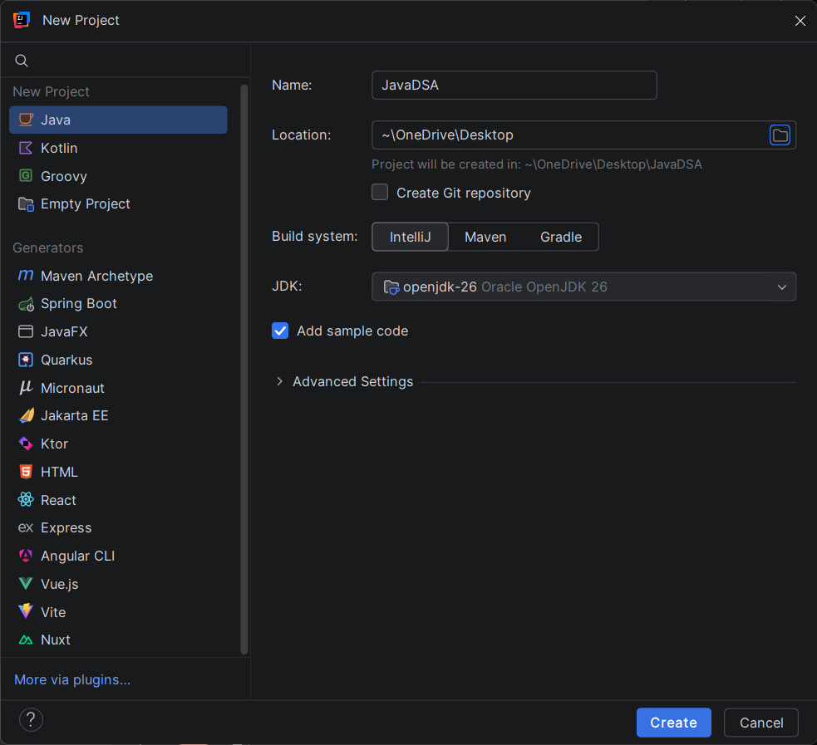
Option 2: IntelliJ IDEA (Professional IDE)

Slide 53
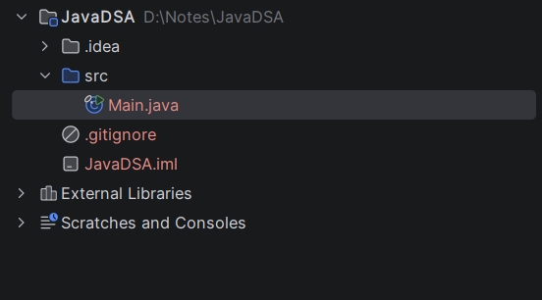
Option 2: IntelliJ IDEA (Professional IDE)
STEP 4: Project Structure
JavaDSA/ → Project Root
src/ → Source Folder (Write code here)
Main.java → Default Java file
External Libraries/ → Pre-loaded Java Libraries (JRE)

Slide 54
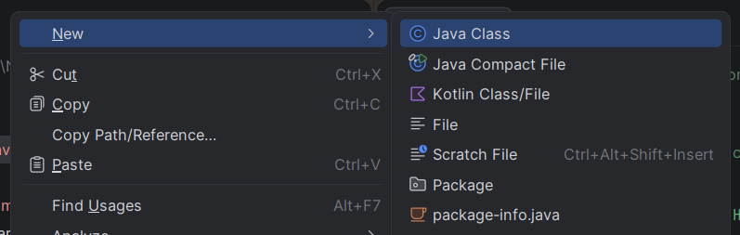
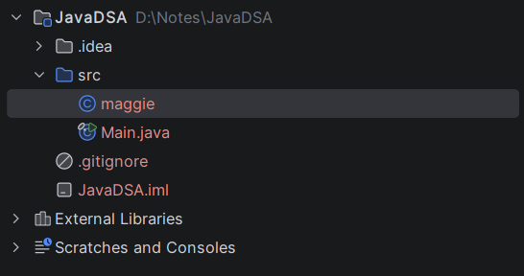
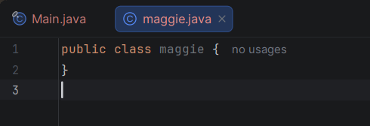
Option 2: IntelliJ IDEA (Professional IDE)
STEP 5: Create our own Java File
Right click on “src” folder.
Click “New”.
Click “Java Class”.
Enter class name (e.g., maggi).
File created: maggi.java

Slide 55
Option 2: IntelliJ IDEA (Professional IDE)
STEP 6: Run a Java File
Open any .java file
Click the GREEN ARROW button on the left of “main”.
Select “Run”.
Output appears in the bottom console window.

Slide 56
Online Compiler vs IntelliJ IDEA
Feature | Online Compiler | IntelliJ IDEA
Setup needed | No ❌ | Yes (one-time) ✅
Internet required | Yes ✅ | No ❌
Multiple files | Limited ❌ | Yes ✅
Project Structure | No ❌ | Yes ✅
Debugger | No ❌ | Yes ✅
Used in companies | Rarely ❌ | Yes (Industry standard) ✅
Best for | Quick testing | Full development

Slide 57
Lecture 3 - Questions
What is an IDE ?
An IDE (Integrated Development Environment) is a software application that provides comprehensive tools for software development – including a code editor, compiler, debugger, nd build tools – all in one place.

Slide 58
Lecture 3 - Questions
Why is IntelliJ IDEA preferred for Java development ?
IntelliJ IDEA is preferred because it provides smart code completion, built-in compiler and debugger, organized project structure, library management, and is the industry standard used by most Java-based companies.

Slide 59
Lecture 3 - Questions
What happens when we click Run in IntelliJ ?
IntelliJ internally runs the Java compiler (from JDK) to convert .java to Byte Code, then JVM converts Byte Code to Machine Code and executes it, showing output in the console.

Slide 60
Lecture 3 - Questions
What is the difference between Online compiler & IDE ?
Online compiler is browser-based, needs internet, good for quick single-file testing.
IDE is installed locally, supports multiple files, project organization, debugging – used for professional development.

Slide 61
Lecture 4 – Write your FIRST Java Program

Slide 62
Function / Method
Definition:
A Function (C++) or Method (Java) is an entity created to perform a single responsibility / single task. It takes input & return output.
Key points:
In C++ → called Function.
In Java → called Method.
Both terms mean the same thing – used interchangeably.
Named such that its name reflects its task.

Slide 63
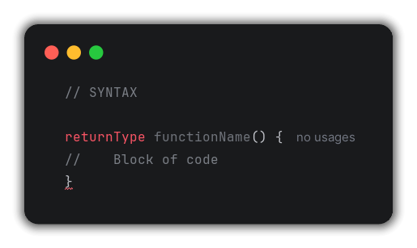
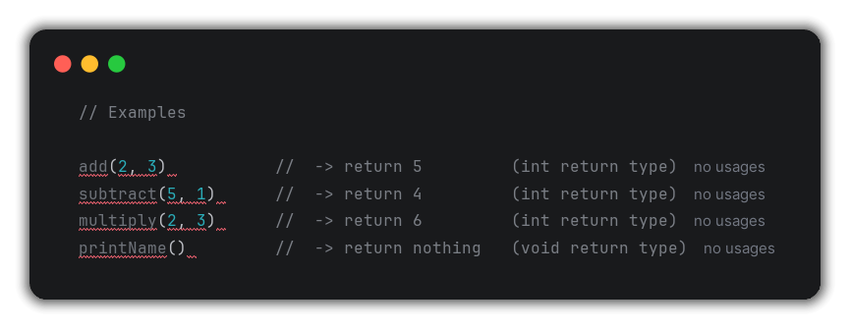
Function / Method

Slide 64
Return Types
Definition:
Return Type tells us what type of value a function / method will return after execution.
Key Rule:
If a function does NOT return any value, its return type is void.
Return Type | Meaning | Example
int | Returns an integer number | add() returns 5
char | Returns a single character | Returns ‘A’
String | Returns a sequence of characters | Returns “Lav”
void | Returns nothing | printName()

Slide 65
Block of Code (Curly Brackets {})
Definition:
Curly brackets {} defines a Block of code – all code written inside these brackets belongs to that function / method.
Analogy:
Just like money inside a wallet belongs to the wallet’s oner – code inside {} belongs to that function.

Slide 66
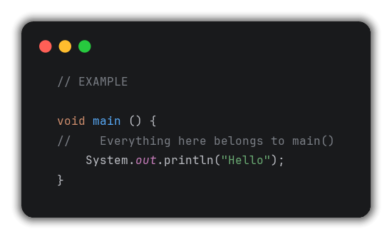
Block of Code (Curly Brackets {})

Slide 67
Main Function – Entry Point
Definition:
main is a special function that acts as the Entry Point of a Java program – execution always starts from here.
Why main ?
A code file can have thousands of lines.
The compiler needs to know where to start execution.
main function = Starting point = entry point.
Without main, program doesn’t know where to begin.

Slide 68
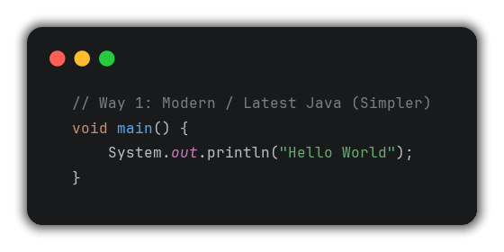
Main Function – Entry Point
Two ways to write Main in Java:
Way 1: Modern / Latest Java (Simpler)

Slide 69
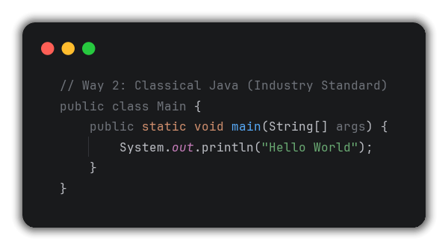
Main Function – Entry Point
Way 2: Classical Java (Industry Standard)

Slide 70
Main Function – Entry Point
Breaking down Classical Main:
Part | Meaning | Known Now ?
public | Access Modifier | Later (OOPs)
class Main | Container / box for all code | Basic understanding now, detail later
static | Keyword | Later (OOPs)
void | Return type → returns nothing | Yes ✅
main | Function name → entry point | Yes ✅
String[] args | Command line arguments | Later
{} | Block of code belonging to main | Yes ✅
; | Line terminator | Yes ✅
Shortcut in IntelliJ:
psvm + Tab → auto-generates public static void main(String[] args)

Slide 71
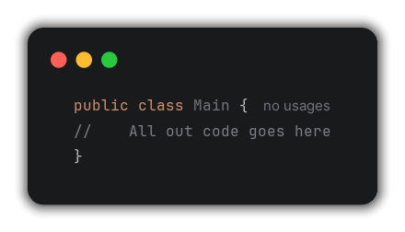
Class
Definition (Basic for now):
A Class is a container / box that holds all our code.
Every Java program must have at least one class.
Deep dive into Class → covered in OOPs lectures later in the series.

Slide 72
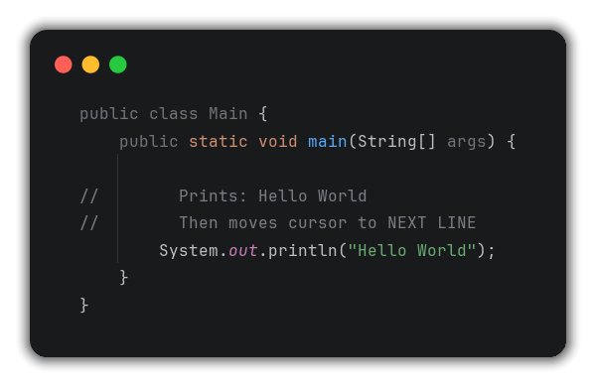
System.out.println vs System.out.print
System.out.println (Print + new line)

Slide 73
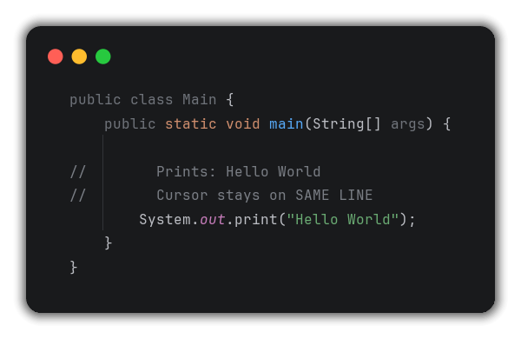
System.out.println vs System.out.print
System.out.print (Print only, no new line)

Slide 74
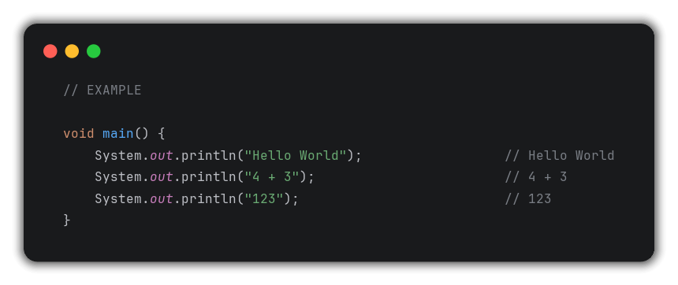
String
Definition:
A String is a sequence of characters written inside double inverted commas “ ”.

Slide 75
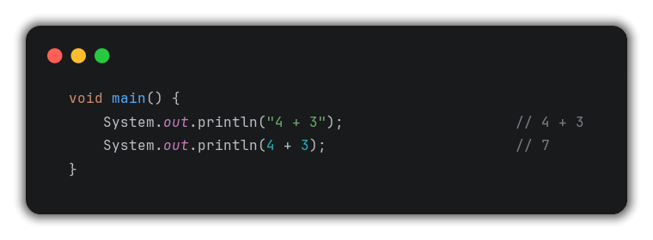
String
Key Rule:
Anything inside “” is treated as a String – NOT evaluated mathematically.

Slide 76
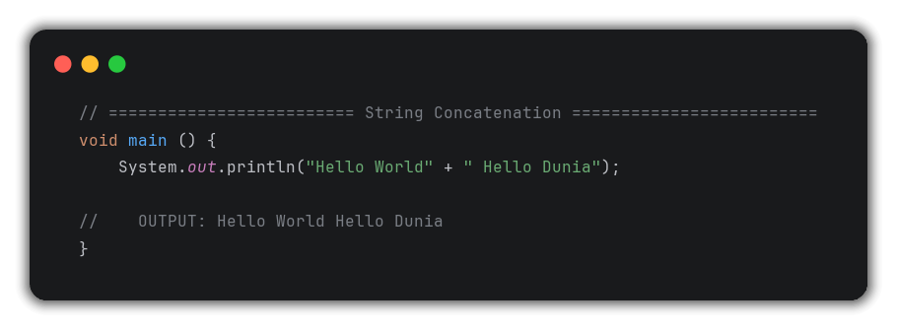
String Concatenation
Definition:
Concatenation = Joining 2 or more Strings using + operator

Slide 77
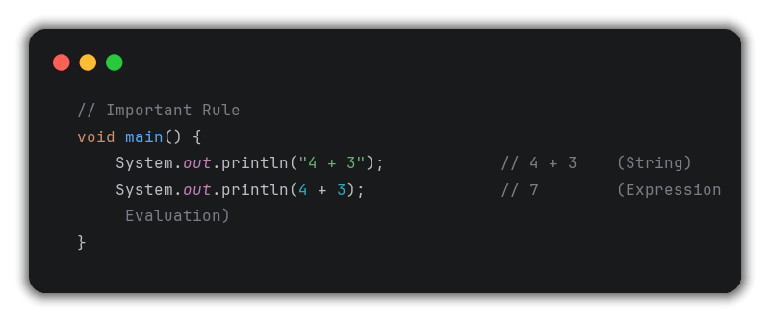
String Concatenation
Important Rule:

Slide 78
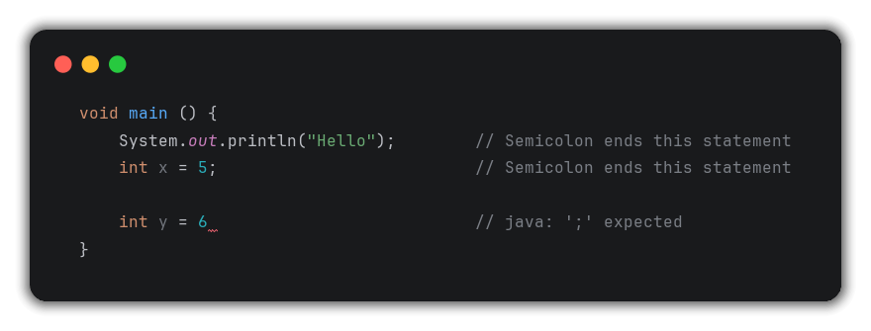
Semicolon
Definition:
Semicolon ; marks the end / termination of a statement in Java.

Slide 79
Comments
Definition:
Comments are lines in code that are ignored by the compiler – they do NOT execute.
Used for documentation & explanation.
There are 2 types of comments:
Single-line comments (//)
Multi-line Comments (/* */)

Slide 80
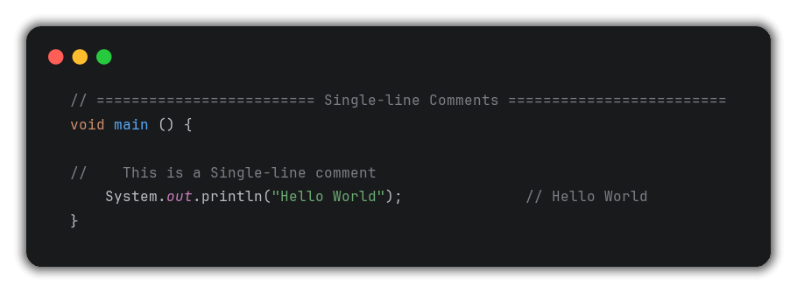
Comments
Type 1: Single-line Comments

Slide 81
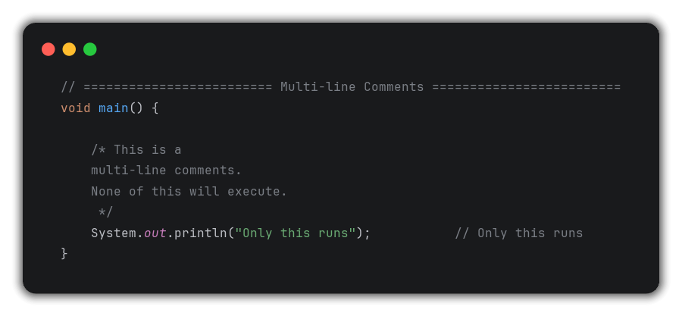
Comments
Type 2: Multi-line Comments

Slide 82
Comments
When to use comments ?
Explain complex logic
Temporarily disable code without deleting it.
Add documentation to our code.

Slide 83
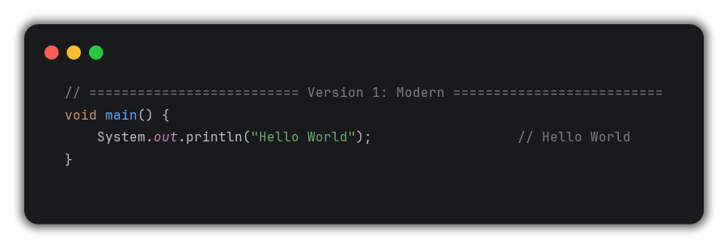
Complete First Java Program
Version 1: Modern (Latest)

Slide 84
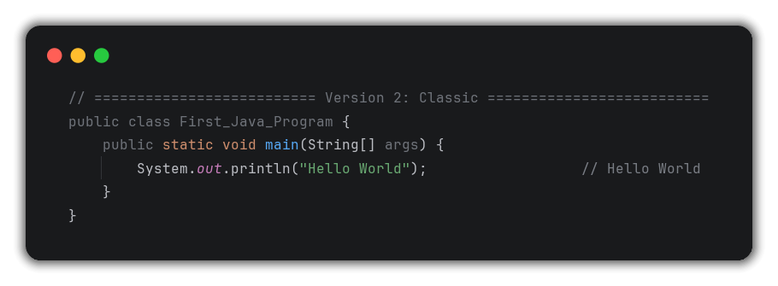
Complete First Java Program
Version 2: Classic (Industry Standard)

Slide 85
Lecture 4 - Questions
What is the entry point of a Java program ?
The main method – public static void main(String[] args)
JVM always starts execution from here.

Slide 86
Lecture 4 - Questions
What is the difference between System.out.println & System.out.print ?
println prints the content AND moves cursor to the next line.
print only prints the content – cursor stays on the same line.

Slide 87
Lecture 4 - Questions
What is the return type of the main method & why ?
void – because main doesn’t return any value to the caller.

Slide 88
Lecture 4 - Questions
What is a String in Java ?
A string is a sequence of characters enclosed in double quotes “”.
Anything inside “” is treated as text, not evaluated.

Slide 89
Lecture 4 - Questions
What is the difference between “4 + 3” & 4 + 3 ?
“4 + 3” is a String – printed as-is.
4 + 3 is an arithmetic expression – evaluated first (=7), then printed.

Slide 90
Lecture 4 - Questions
What are comments in Java & what are the types ?
Comments are non-executed lines ignored by compiler.
Types:
Single-line → //
Multi-line → /* */

Slide 91
Lecture 5 – Variables

Slide 92
1. What is a Variable ?
A Variable is a named storage location in memory used to store, read, update, and access data.
Memory Analogy:
Memory → Big building with many rooms.
Variable → Name given to a specific room.
Value → What’s stored inside that room.

Slide 93
Why do we need Variables ?
Data is stored in memory locations.
To access / modify a memory location → we need its name.
Variable provides that name to the memory location.
Without a name → cannot access → cannot perform operations.

Slide 94
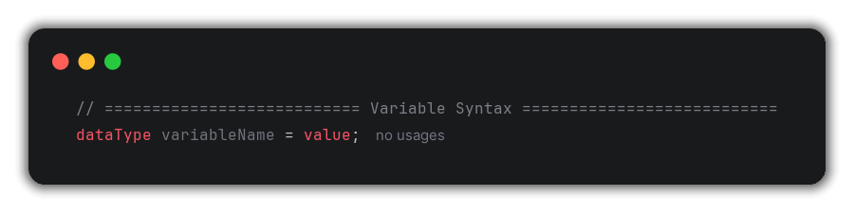
2. Variable Syntax
Part | Example | Meaning
datatype | int | Type of data to be stored
variableName | age | Name given to memory location
= | = | Assignment Operator (Stores value into variable)
value | 5 | Actual value stored in memory

Slide 95
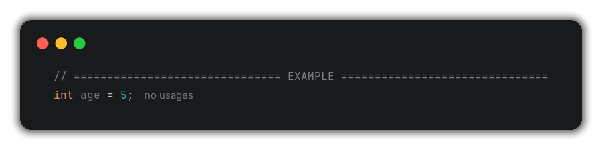
2. Variable Syntax
What happens in memory:
Memory Block → Named “age” → Contains value “5” → Type: Integer

Slide 96
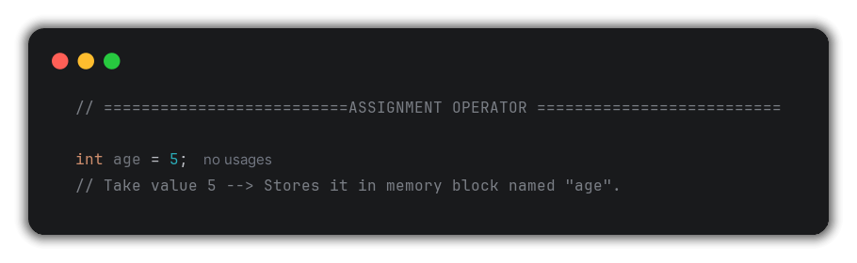
3. Assignment Operator (=)
The Assignment Operator (=) assign / stored the value on the right side into the variable on the left side.
= in Java is NOT “equals to” – it means “assign”

Slide 97
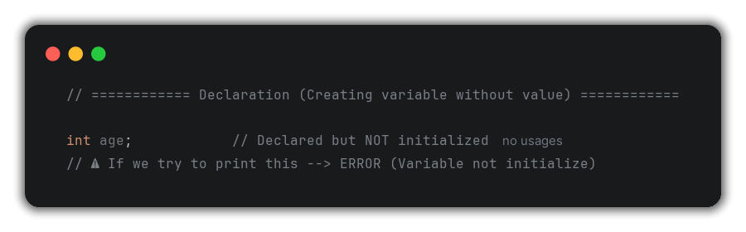
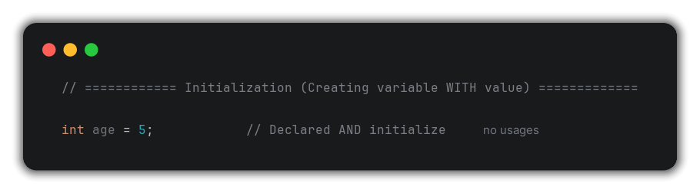
4. Declaration vs Initialization

Slide 98
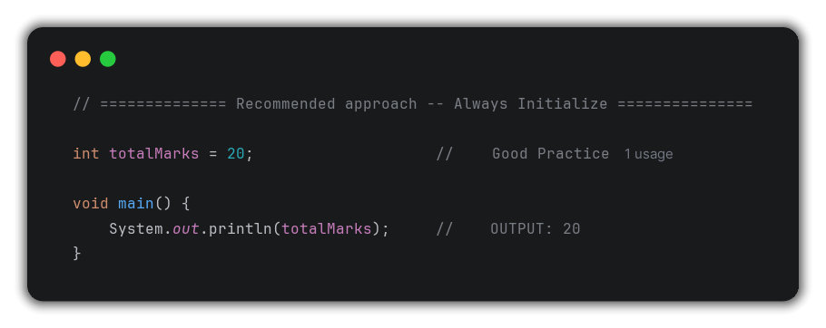
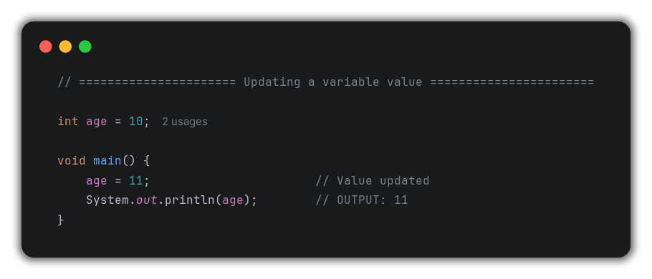
4. Declaration vs Initialization

Slide 99
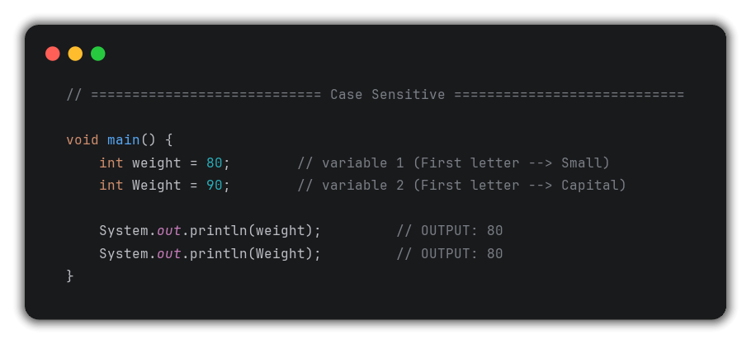
5. Variable Naming Rules
RULE 1: Case Sensitive
Java is case sensitive – age and AGE are two different variables.

Slide 100
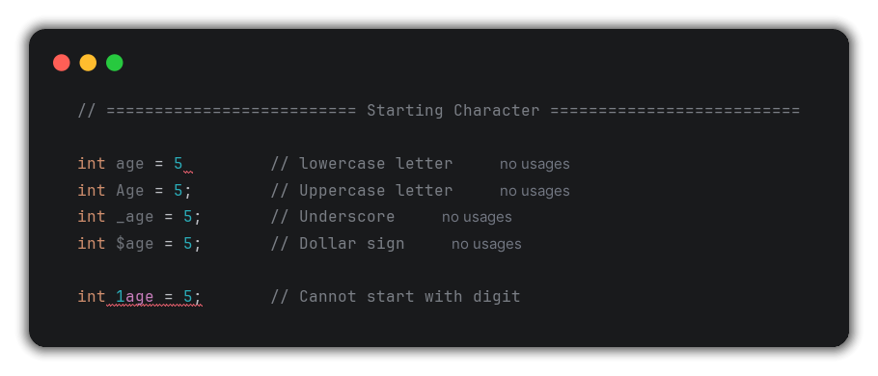
5. Variable Naming Rules
RULE 2: Starting Character
Variable name can START with:
Allowed | Example
Lowercase letter | age, name
Uppercase letter | Age, Name
Underscore (_) | _age, _name
Dollar sign ($) | $age, $name

Slide 101
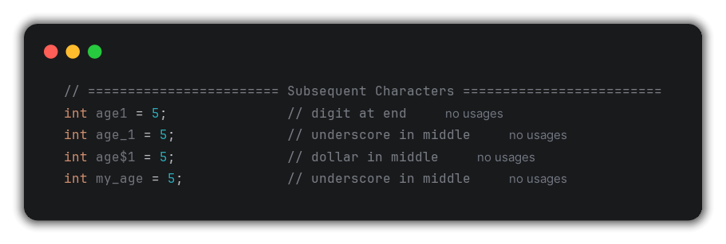
5. Variable Naming Rules
RULE 3: Subsequent Characters
After the first character, we can use:
Allowed | Example
Letters (a – z, A – Z) | age1, Age
Digits (0 – 9) | age1, var2
Underscore (_) | My_age
Dollar sign ($) | my$age

Slide 102
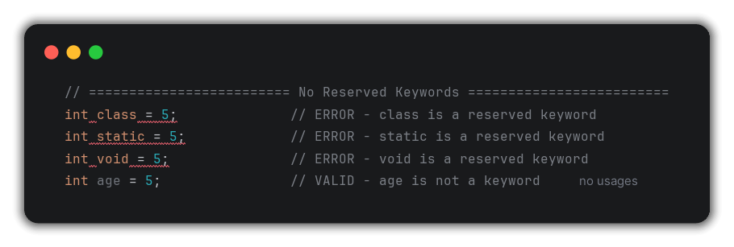
5. Variable Naming Rules
RULE 4: No reserved Keywords
Reserved keywords are words that have a specific predefined meaning in Java – they CANNOT be used as variable names.

Slide 103
5. Variable Naming Rules
Some Java Reserved Keywords:
abstract | assert | boolean | break | byte
case | catch | char | class | const
continue | default | do | double | else
enum | extends | final | finally | float
for | goto | if | implements | import
instanceof | int | interface | long | native
new | package | private | protected | public
return | short | static | super | switch
synchronized | this | throw | throws | try
void | volatile | while | strictfp | transient
Java has approximately 50 reserved keywords.

Slide 104
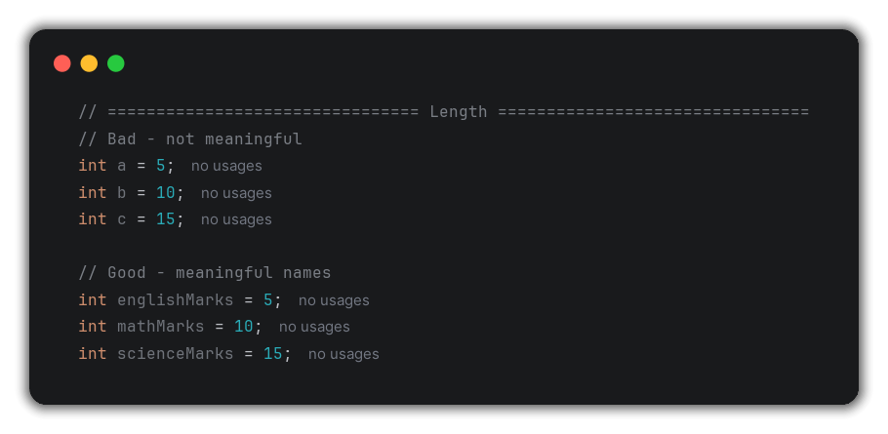
5. Variable Naming Rules
RULE 5: Length – Keep it Meaningful
No strict length limit BUT variable names must be meaningful and intuitive.

Slide 105
6. Naming Conventions
Convention 1: camelCase (for regular variables)
camelCase: First word all lowercase, every subsequent word starts with Uppercase.
Rules:
First word → ALL lowercase
Every next word → First letter UPPERCASE, rest lowercase.

Slide 106
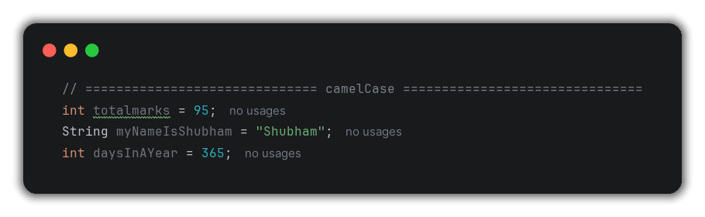
6. Naming Conventions
Examples:
Multiple Words | camelCase Variable
my name is shubham | myNameIsShubham
total marks | totalMarks
days in a year | daysInAYear
my age | myAge
Student roll number | studentRollNumber

Slide 107
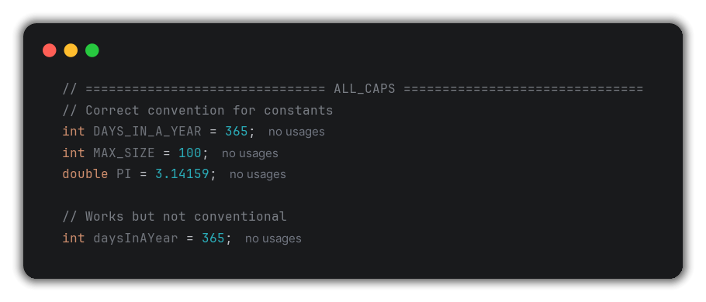
6. Naming Conventions
Convention 2: ALL_CAPS (for Constants)
Constants = Values that never change – use ALL UPPERCASE with underscore.
In real production code → all constants are UPPER_CASE

Slide 108
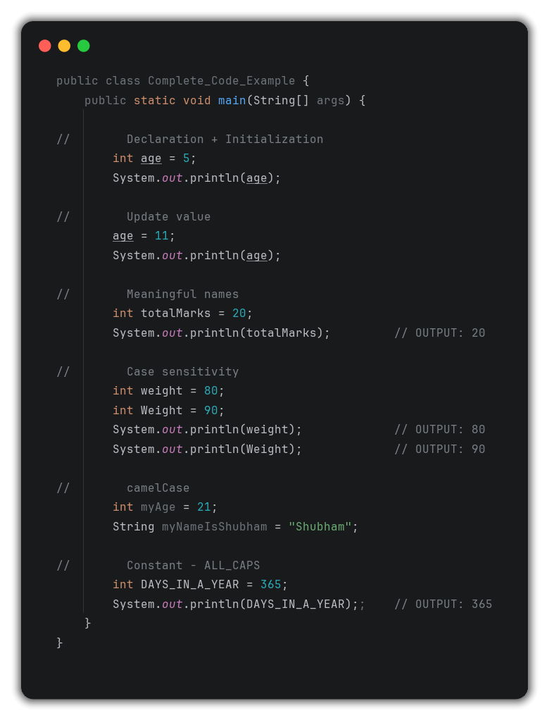
7. Complete Code Example

Slide 109
Lecture 5 - Questions
What is a variable in Java ?
A Variable is a named storage location in memory that holds data of a specific type.
It allows us to read, write, update, and access data stored at the memory location.

Slide 110
Lecture 5 - Questions
What is the difference between variable declaration and initialization ?
Declaration: Creating a variable without assigning value (int age;).
Initialization: Declaring AND assigning a value at the same time (int age = 5;).
Using an uninitialized variable cause a compile error.

Slide 111
Lecture 5 - Questions
Is Java case sensitive ?
Yes, age, Age, and AGE are three completely different variables in Java.

Slide 112
Lecture 5 - Questions
What are reserved keywords ? Give examples.
Reserved keywords are predefined words with specific meaning in Java – they cannot be used as variable names.
Examples:
class,
static,
void,
int,
for, etc.

Slide 113
Lecture 5 - Questions
What is camelCase & when is it used ?
camelCase is a naming convention where the first word is all lowercase and every subsequent word starts with uppercase.
Used for regular variable names.
Example:
totalMarks,
myAge,
studentRollNumber, etc

Slide 114
Lecture 5 - Questions
What naming convention is used for constants in Java ?
ALL_CAPS with underscores.
Example:
DAYS_IN_A_YEAR = 365,
MAX_SIZE = 100
This signals that the value never changes.

Slide 115
Lecture 6 – Data Types & Type Casting in Java

Slide 116
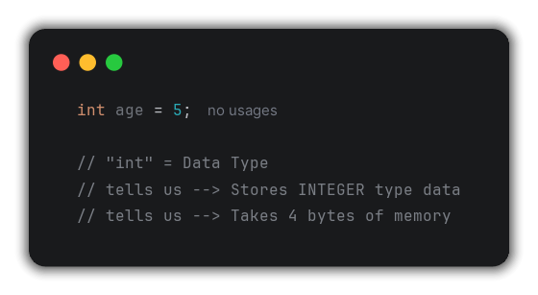
1. What is a Data Type ?
Definition:
A Data Type is an entity that defines what kind of data a variable will store & work with.
Every Data Type tells us TWO things:
Information | Example
Type of Data | integer, character, decimal, true / false
Size of Data | How many bytes it occupies in memory

Slide 117
2. Category of Data Types in Java
Data Type in Java
Primitive Data Type
Non-Primitive Data Types
Non-Numeric Type
Numeric Type
Boolean
Char
Integer
Floating point
byte
short
int
long
Float
double
String
Array
etc.

Slide 118
3. Primitive Data Type
Data Type | Size | Range | Default Value | Use Case
byte | 1 byte (8 bits) | -128 to 127 | 0 | Very small integers
short | 2 bytes (16 bits) | -32768 to 32767 | 0 | Small integer
int | 4 bytes (32 bits) | -2147483648 to 2147483647 | 0 | Most common integer use
long | 8 bytes (64 bits) | -2⁶³ to (2⁶³ – 1) | 0L | Very large integers
float | 4 bytes (32 bits) | ~6-7 decimal digits precision | 0.0f | Less precise decimal
double | 8 bytes (64 bits) | ~15 decimal digit precision | 0.0d | High precision decimals
char | 2 bytes (16 bits) | 0 to 65535 (Unicode) | ‘\u0000’ | Single Character
boolean | 1 bit | True / false | false | Conditions / flags

Slide 119
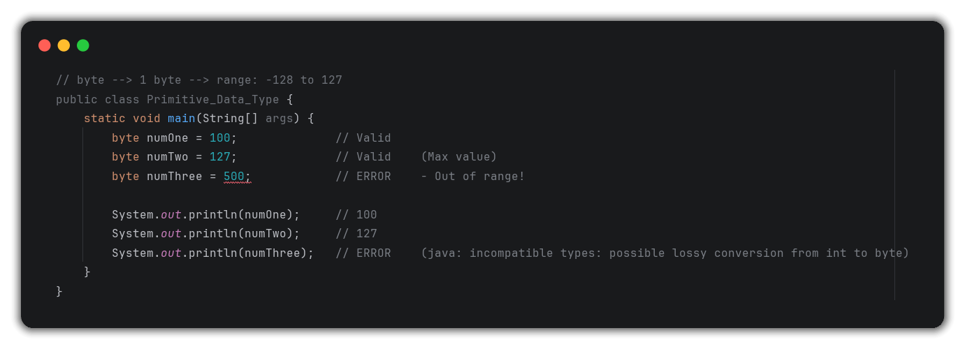
4. All Primitive Data Types
Numeric Type (Integer) → byte
Key Rule: Always stay within the data type’s range – going out of range cause Incompatible Type Error.

Slide 120
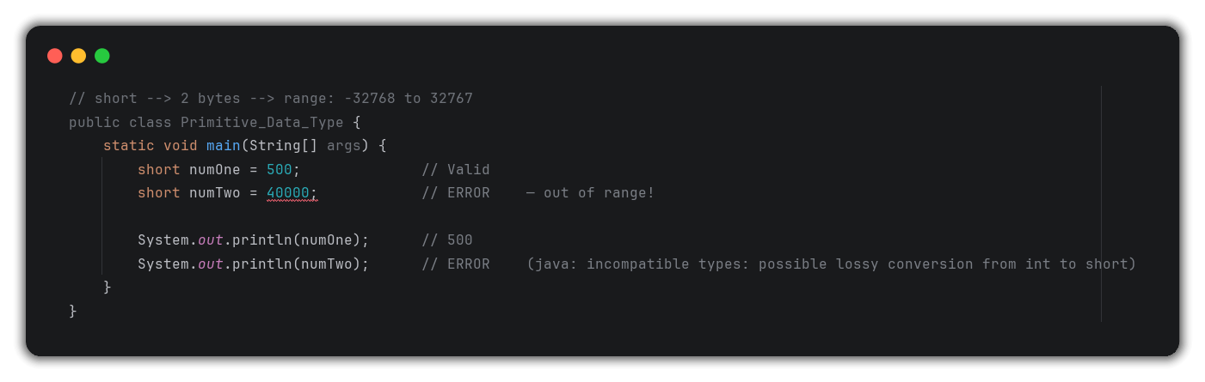
4. All Primitive Data Types
Numeric Type (Integer) → short
Key Rule: Always stay within the data type’s range – going out of range cause Incompatible Type Error.

Slide 121
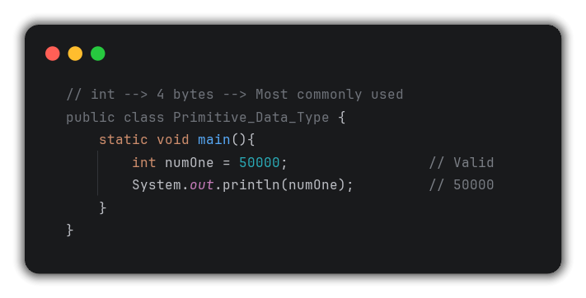
4. All Primitive Data Types
Numeric Type (Integer) → int

Slide 122
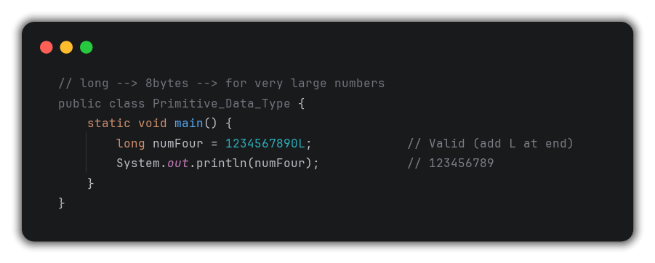
4. All Primitive Data Types
Numeric Type (Integer) → long

Slide 123
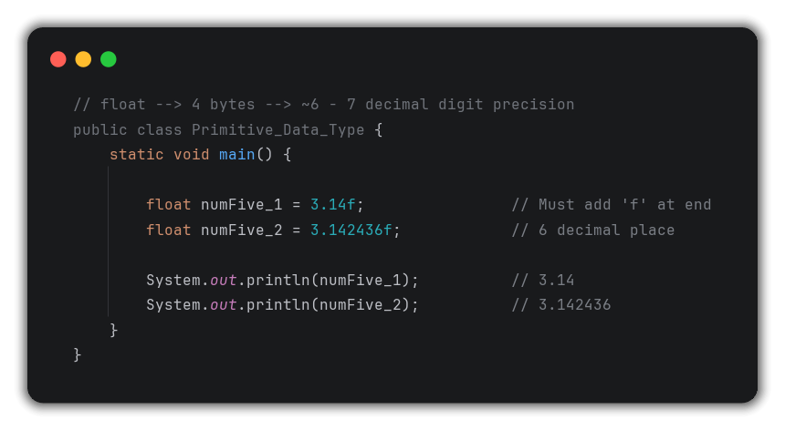
4. All Primitive Data Types
Numeric Type (Floating Point) → float
Key Rule: Always add f suffix → 3.14f

Slide 124
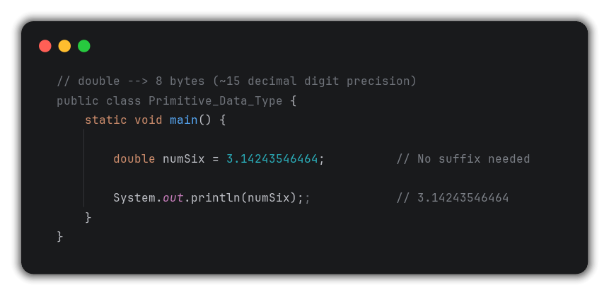
4. All Primitive Data Types
Numeric Type (Floating Point) → double
Float vs double: Use float for less precision, double for more precision.

Slide 125
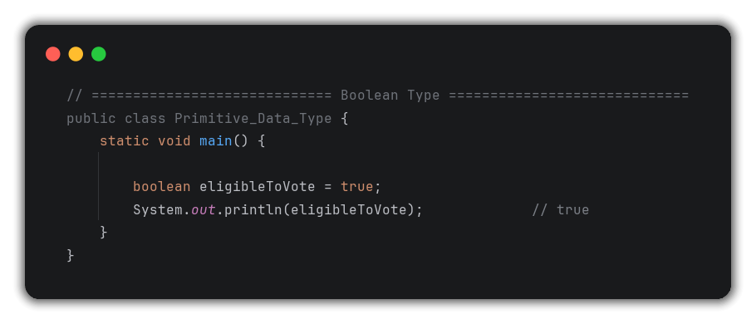
4. All Primitive Data Types
Non-Numeric Type → Boolean

Slide 126
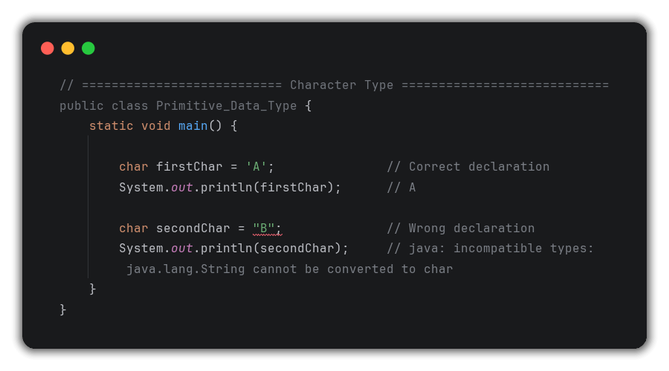
4. All Primitive Data Types
Non-Numeric Type → Character

Slide 127
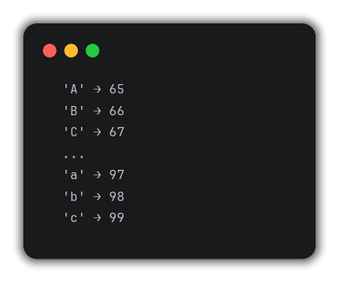
5. ASCII Values (Character Mapping)
Definition:
Every character has a numeric value mapped to it called its ASCII Value (American Standard Code for Information Interchange).
How it works:

Slide 128
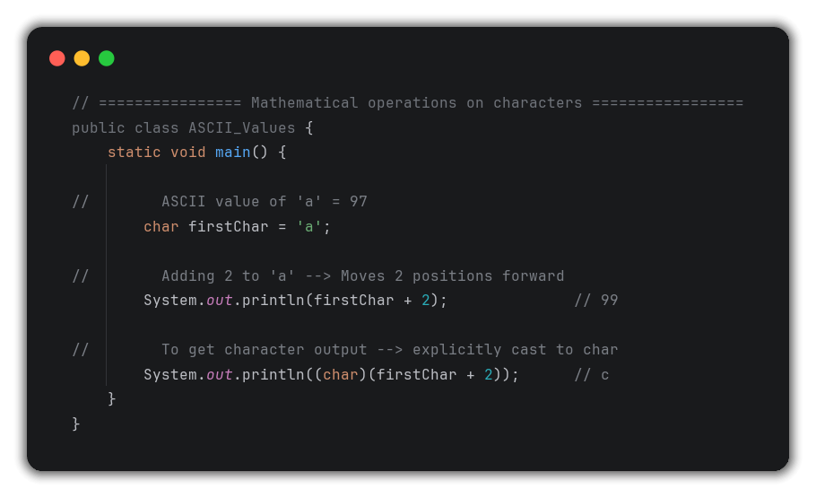
5. ASCII Values (Character Mapping)
Mathematical Operations on Characters:
Key Point: We don’t need to memorize ASCII values – just understand the concept that characters are mapped to numbers.

Slide 129
6. Type Casting (Type Conversion)
Definition:
Type Casting = Converting a value from one data type to another.
Types of Type Casting:
Implicit Conversion (widening) → automatic
Explicit Conversion (Narrowing) → manual

Slide 130
6.1. Implicit Conversion (Widening)
Definition:
Implicit Conversion = Converting a smaller data type to a large data type – happened automatically, no extra effort needed.
Memory Analogy:
Small box (1 byte) → can easily fit into → Big box (8 bytes)
Direction (always small → big):
byte → short → int → long → float → double

Slide 131
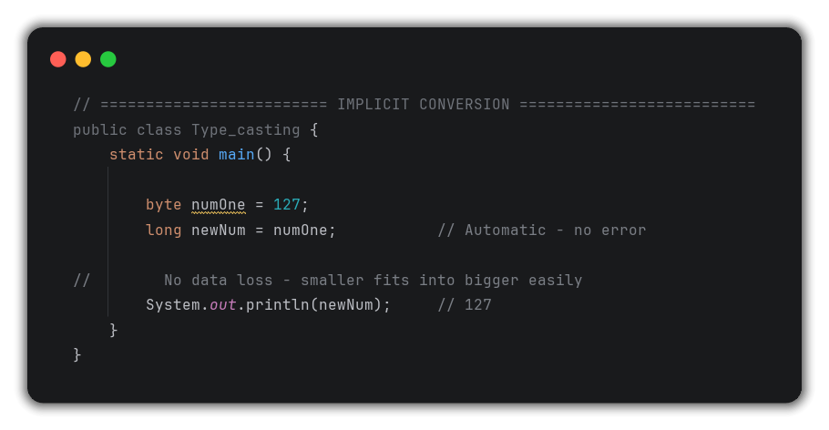
6.1. Implicit Conversion (Widening)
Code Example

Slide 132
6.2. Explicit Conversion (Narrowing)
Definition:
Explicit Conversion = Converting a larger data type to a smaller data type – requires manual casting and may cause data loss.
Direction (big → small, risky):
Double → float → long → int → short → byte

Slide 133
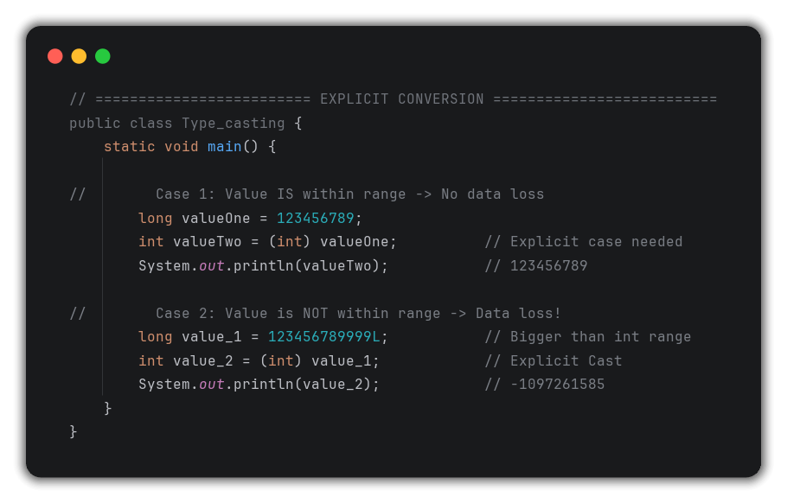
6.2. Explicit Conversion (Narrowing)
Code Example

Slide 134
7. Implicit vs Explicit
Feature | Implicit (Widening) | Explicit (Narrowing)
Direction | Small → Big | Big → Small
Automatic ? | Yes ✅ | No ❌
Extra Syntax ? | No ❌ | Yes ✅
Data loss ? | No ❌ | Possible ⚠️
Example | byte → long | long → int

Slide 135
Lecture 6 - Questions
What is a data type & what two things does it tells us ?
A data type defines what king of data a variable stores.
It tells us:
Type of data (byte, short, int, long, boolean, char),
Size of data (bytes it occupies in memory).

Slide 136
Lecture 6 - Questions
What is the difference between float & double ?
Both store decimal values.
float = 4 bytes, ~6-7 decimal digits precision, requires f suffix.
double = 4 bytes, ~15 decimal digit precision, no suffix needed.
Use double when higher precision is required.

Slide 137
Lecture 6 - Questions
What is implicit VS explicit type casting ?
Implicit = Automatic conversion from smaller to large data type (no data loss, no extra syntax needed).
Explicit = Manually conversion from larger to small data type (possible data loss, require (datatype) syntax).

Slide 138
Lecture 6 - Questions
What is an ASCII value ?
ASCII (American Standard Code for Information Interchange) is a numeric value mapped to every character.
Example:
‘A’ = 65,
‘a’ = 97
Using these values, mathematical operations can be performed on characters.

Slide 139
Lecture 6 - Questions
Why can’t we use 1 for true in Java like in C++ ?
Java is strictly typed – boolean only accepts true or false.
Unlike C++, Java doesn’t treat 1 as true or 0 as false.
Assigning an integer to a boolean causes a compile error.

Slide 140
Lecture 6 - Questions
What happens when we store a value outside a data type’s range ?
We get an incompatibleType compiler error.
Is we force it with explicit casting, data loss occurs and we get an unexpected / garbage value.

Slide 141
Lecture 6 - Questions
What is the difference between primitive and non-primitive data types?
Primitive = built-in basic types provided by Java (byte, short, int, long, float, double, char, boolean) – store simple values directly.
Non-primitive = Complex types (String, Array, Class, interface) – refer to objects and are covered in OOPs.

Slide 142
Lecture 7 – Operators in Java

Slide 143
1. What is an Operator ?
Definition:
An Operator is a special symbol that performs some operation on values or variables.
Types of Operators in Java:
Type | Purpose
Arithmetic Operator | Mathematical Calculation
Relational Operator | Comparison between values
Logical Operator | Combining Conditions
Assignment Operator | Assigning values to variable
Unary Operator | Operations on single operand
Bitwise Operator | Bit-level operations (Covered later0

Slide 144
2. Arithmetic Operator
Definition:
Used for: Mathematical Calculations.
Operator | Name | Example | Result
+ | Addition | 2 + 3 | 5
- | Subtraction | 3 – 2 | 1
* | Multiplication | 2 * 3 | 6
/ | Division | 6 / 3 | 2
% | Modulus (Remainder) | 5 % 2 | 1

Slide 145

2. Arithmetic Operator
Integer Division Rule:

Slide 146

2. Arithmetic Operator
Code Example

Slide 147
3. Relational Operator
Definition:
Used for: Comparing 2 values – always returns true or false
Operator | Name | Example | Result
== | Equal to | 5 == 6 | false
!= | Not Equal to | 5 != 6 | true
> | Greater than | 5 > 6 | false
< | Less than | 5 < 6 | true
>= | Greater than or Equal | 5 >= 5 | true
<= | Less than or Equal | 5 <= 6 | true

Slide 148

3. Relational Operator
Code Example
NOTE: = is assignment operator, == is equality check – never confuse them!

Slide 149
4. Logical Operators
Definition:
Used for: Combining multiple conditions – always return true or false.
Applied on: Boolean values (true / false) or conditions.
Operator | Name | Symbol | Rule
AND | Logical AND | && | Both must be true → result true
OR | Logical OR | || | Any one true → result true
NOT | Logical NOT | ! | Reverses the value

Slide 150
4. Logical Operators
Truth Table – Logical AND (&&)
A | B | A && B
true | true | true
true | false | false
false | true | false
false | false | false
Truth Table – Logical OR (||)
A | B | A || B
true | true | true
true | false | true
false | true | true
false | false | false

Slide 151
4. Logical Operators
Truth Table – Logical NOT (!)
A | !A
true | false
false | true

Slide 152

4. Logical Operators
Code Example

Slide 153

5. Assignment Operators
Definition:
Used for: Assigning values to variables
Basic Assignment

Slide 154
5. Assignment Operators
Shorthand Assignment Operators:
Shorthand | Expanded Form | Example (a = 10) | Result
a += 5 | a = a + 5 | 10 + 5 | 15
a -= 5 | a = a – 5 | 10 – 5 | 5
a *= 5 | a = a * 5 | 10 * 5 | 50
a /= 5 | a = a / 5 | 10 / 5 | 2
a %= 7 | a = a % 7 | 10 % 7 | 3

Slide 155

5. Assignment Operators
Code Example

Slide 156
6. Unary Operators
Definition:
Used for: Operations on a single operand
operator | Symbol | Name | Example
Unary Plus | Positive Indicator | +a | +5 = 5
Unary Minus | Negation | -a | -5
Pre-Increment | Increment then use | ++a
Post-Increment | Use then increment | a++
Pre-Decrement | Decrement then use | --a
Post-Decrement | Use then decrement | a--
Logical NOT | Flip boolean | !a

Slide 157

6. Unary Operators
6.1 Pre-Increment vs Post-Increment
Pre-Increment (++a) → FIRST increment, THEN use/utilize
Post-Increment (a++) → FIRST use/utilize, THEN increment

Slide 158

6. Unary Operators
6.2 Pre-Decrement vs Post-Decrement
Pre-Decrement (--a) → FIRST decrease, THEN use/utilize
Post-Decrement (a--) → FIRST use/utilize, THEN decrease

Slide 159

6. Unary Operators
6.3 Combined Pre/Post Example

Slide 160

6. Unary Operators
6.4 Logical Not (!)

Slide 161
7. Bitwise Operators (Coming Later)
Not Covered in this lecture – will be taught after Binary Number System and memory representation lecture
Preview of What’s coming:
Operator | Symbol | Example | Description
Bitwise AND | & | a & b | Bitwise AND of value
Bitwise OR | | | a | b | Bitwise OR
Bitwise XOR | ^ | a ^ b | True if bit differ
Bitwise NOT | ~ | ~a | Inverts all bits
Left shift | << | a << 1 | Shifts bits left
Right Shift | >> | a >> 1 | Shifts bits right

Slide 162
Lecture 7 - Questions
What is the difference between = and == in Java ?
= is the assignment operator – assigns a value to a variable.
== is the equality – relational operator – checks if two values are equal and return true / false.

Slide 163
Lecture 7 - Questions
What is the Modulus operator and what it returns ?
The modulus operator % returns the remainder after dividing.
Example:
10 % 3 == 1 (Since 10 = 3 * 3 + 1)

Slide 164
Lecture 7 - Questions
What is the difference between pre-increment & post-increment ?
Pre-Increment (++a) → Increment first, then uses the value.
Post-Increment (a++) → Uses the current value first, then increments.
Both increases by 1, but timing of use differs.

Slide 165
Lecture 7 - Questions
What does a += 5 mean ?
It is shorthand for a = a + 5 – adds 5 to the current value of a and stores the result back in a.

Slide 166
Lecture 7 - Questions
What is the output of:
int a = 5;
System.out.println(a++);
5, Post-Increment uses current value (5) first, then increments a to 6.

Slide 167
Lecture 7 - Questions
What is the output of:
int a = 5;
System.out.println(++a);
6, Pre-Increment increments a to 6 first, then prints.

Slide 168
Lecture 7 - Questions
What is the result of 10 / 3 in Java ?
3 – because both integers, Java perform integer division and drops the decimal.
Use (double)10/3) to get 3.333…..

Slide 169
Lecture 7 - Questions
When would we use logical operators ?
When combining multiple conditions.
Example:
Checking if a user is eligible to vote – age > 18 AND is a citizen → use &&.
Is either condition satisfies – use ||

Slide 170
Lecture 8 – Input/Output in Java

Slide 171

1. Taking Input in Java
The Problem with Hard-Coded Values:
The solution → Scanner class:
Java provides a built-in Scanner class to take input from the user at runtime.

Slide 172
2. Scanner Class
Definition:
Scanner is a Java class that provides method to read/take different types of input (int, float, String, boolean, etc.) from the user during program execution.

Slide 173


3. Setting up Scanner – Step by Step
Step 1: Import Scanner
Step 2: Create Scanner Object

Slide 174


3. Setting up Scanner – Step by Step
Step 3: Use Scanner method to take input
Step 4: Close Scanner (Best Practice)

Slide 175

3. Setting up Scanner – Step by Step

Slide 176
4. All Scanner Methods
Method | Data Type Read | Example
sc.nextInt() | int | int a = sc.nextInt();
sc.nextLong() | long | long l = sc.nextLong();
sc.nextShort() | short | short s = sc.nextShort();
sc.nextByte() | byte | byte b = sc.nextByte();
sc.nextFloat() | float | float f = sc.nextFloat();
sc.nextDouble() | double | double d = sc.nextDouble();
sc.nextBoolean() | boolean | boolean b = sc.nextBoolean();
sc.next() | String(single word) | String s = sc.next();
sc.nextLine() | String (Full line) | String line = sc.nextLine()
sc.nextBigInteger() | BigInteger (Very large) | BigInteger bi = sc.nextBigInteger();

Slide 177

5. Program – Multiple Data Type Input

Slide 178

6. Java Garbage Collector
Background – Stack vs Heap Memory:
Definition:
Every Java program has access to 2 types of memory:
Stack Memory → stores local variables, method calls (small, fast).
Heap Memory → stores objects created with new keyword (large, dynamic).

Slide 179
6. Java Garbage Collector
Memory Leak:
Definition:
Memory Leak occurs when heap memory allocated to an Object is NOT freed after the object is no longer needed – that memory remains locked / waster, reducing available memory.

Slide 180
6. Java Garbage Collector
Java’s Solution – Garbage Collector
Definition:
Java Garbage Collector (GC) is an automatic memory management entity in Java that automatically identifies and frees heap memory from object that are no longer reachable / needed – without any manual intervention from the programmer.
What GC does:
Automatically finds objects that are no longer reachable.
Frees the heap memory occupied by those objects.
Prevents memory leaks.
Improves performance by freeing up memory for reuse

Slide 181
Lecture 8 - Questions
How do we take input in Java ?
Using the Scanner class from java.util package.
Create a Scanner object: Scanner sc = new Scanner(System.in), then use methods like sc.nextInt(), sc.nextLine() etc. to read input.

Slide 182
Lecture 8 - Questions
What is the difference between sc.next() and sc.nextLine() ?
sc.next() reads only a single word (stops at space).
sc.nextLine() reads the entire line including spaces until Enter is pressed.

Slide 183
Lecture 8 - Questions
Why should we close the Scanner after use ?
To prevent resource leak — closing the Scanner releases the I/O stream it holds.
It's considered best practice to call sc.close() when done with input.

Slide 184
Lecture 8 - Questions
What is Java Garbage Collector ?
An automatic memory management component of JVM that identifies and frees heap memory from objects that are no longer reachable/referenced — preventing memory leaks without any manual programmer intervention.

Slide 185
Lecture 8 - Questions
What is the difference between Stack and Heap memory ?
Stack stores local variables and method call frames — small, fast, automatically managed.
Heap stores objects created with new keyword — large, dynamic, managed by Garbage Collector.

Slide 186
Lecture 8 - Questions
What is a Memory Leak and how does Java prevent it ?
Memory leak occurs when allocated heap memory is not freed after use — wasting resources.
Java prevents it through the Garbage Collector which automatically detects and frees unreachable objects.

Slide 187
Lecture 8 - Questions
How is memory management different in Java vs C++ ?
In C++, programmer must manually free heap memory using delete/free — failure causes memory leaks.
In Java, the Garbage Collector automatically handles memory deallocation — reducing programmer burden and memory leak risks.

